Slide 1

5.4 (D)
recognize the difference between additive and multiplicative numerical patterns given in a table or graph

Slide 2
Fluency Practice
4, 12, 20, 28, ..?
What is the number pattern above? Is it additive or multiplicative?
What is the number pattern in the table below? Is it additive or multiplicative?
X | Y
1 | 3
2 | 6
3 | 9
4 | ?

Slide 3
Problem Solving Strategies
Intervene’s Problem Solving Strategies:
Step 1: Show what you know
Step 2: Solve and Check
Step 3: Eliminate and Justify

Slide 4
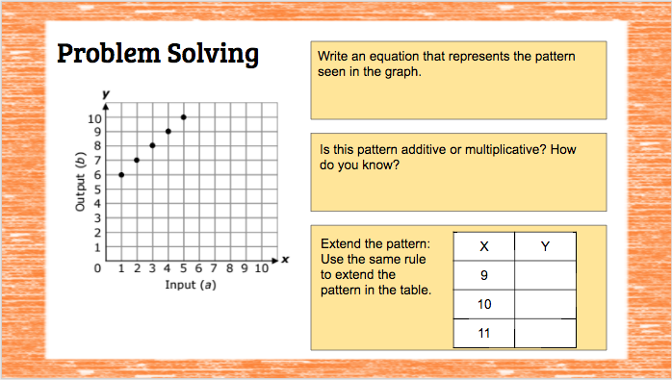
Lesson
Numerical pattern
Multiplicative pattern
Additive pattern

Slide 5
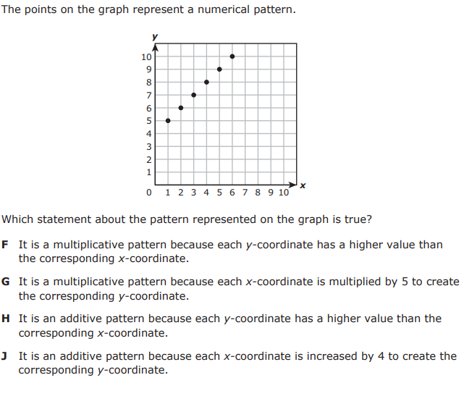
I Do

Slide 6
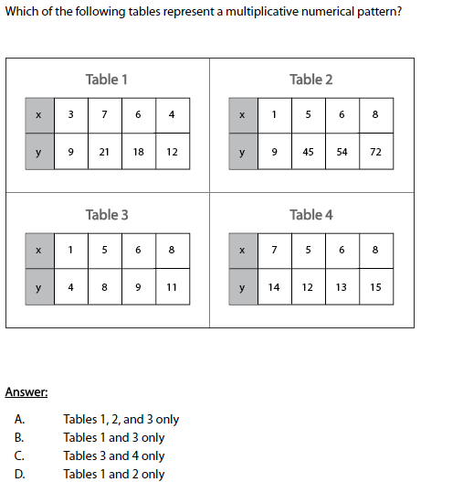
We Do – Student 1

Slide 7
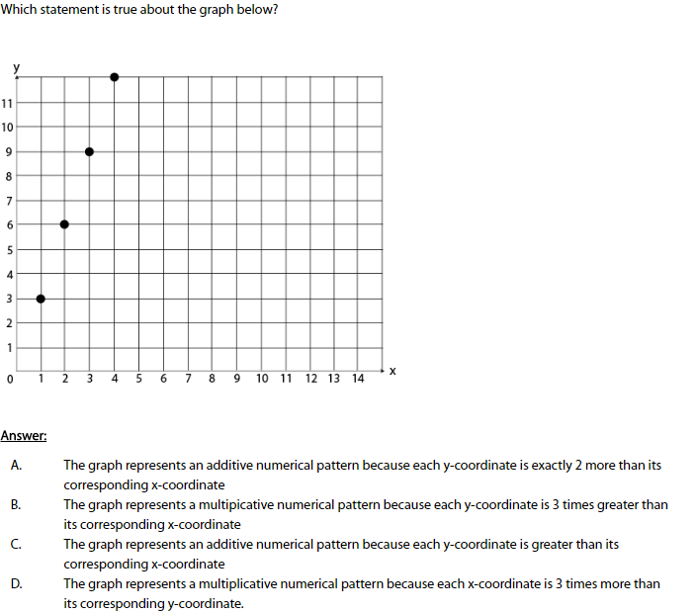
We do - Student 2

Slide 8
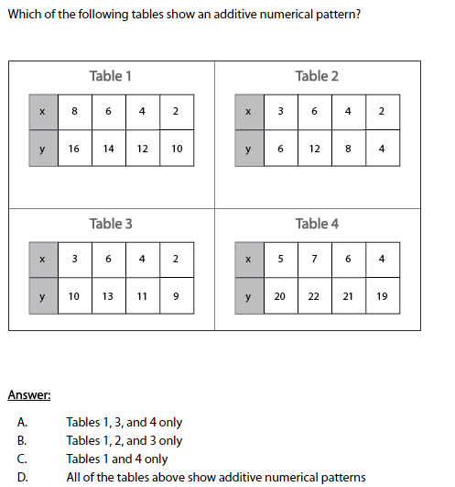
We do - Student 3

Slide 9
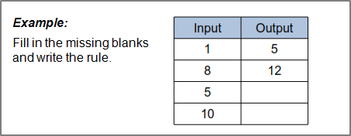
Debrief
Determine the pattern
Additive/multiplicative pattern

Slide 10
You Do
Instructions for Content Dev:
Nothing to do here
Instructions for Tutor:
Have students click on the Quiz tab above (on their screen)
Instruct students to take the quiz on this objective, and remind to use their problem solving strategies

